Slide 1
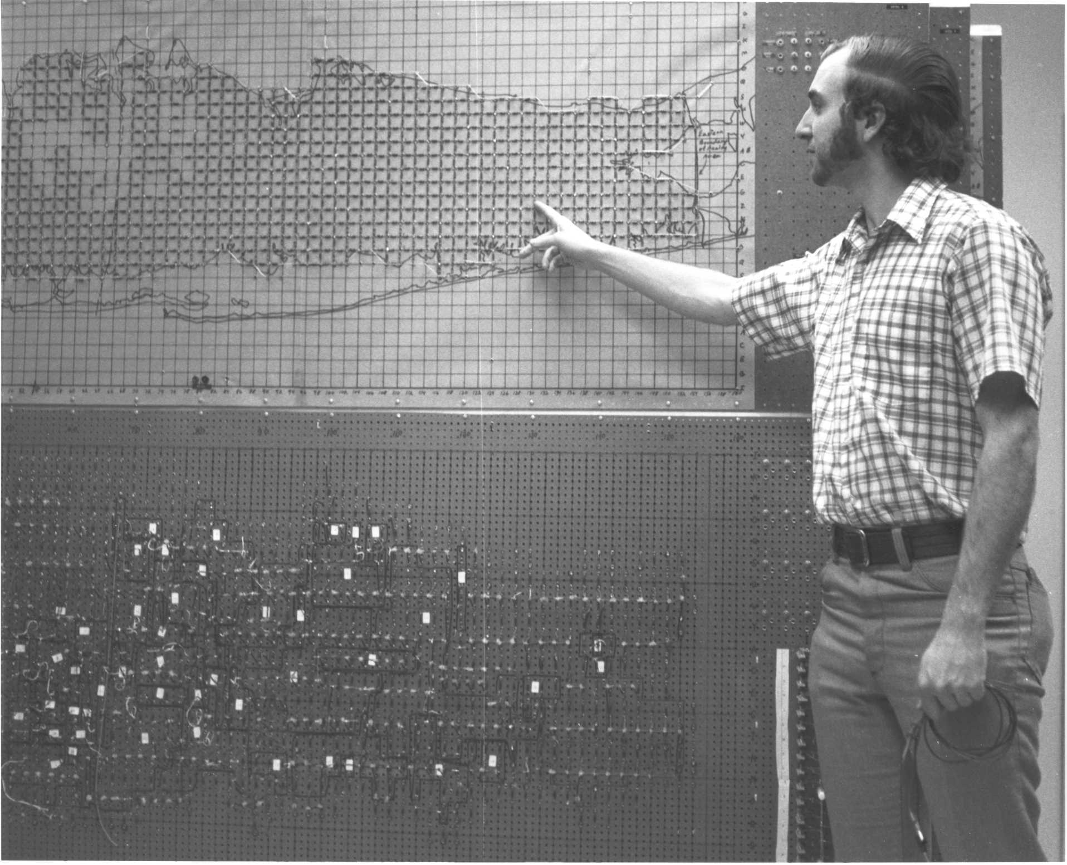
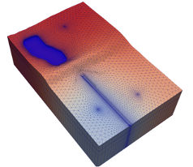
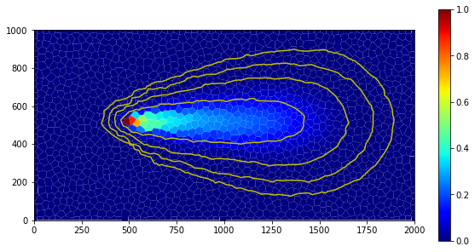



Parallel MODFLOW 6 Concepts and Implementation
Parallel MODFLOW Training Class, July 13-14, 2023, Lakewood, CO
Notes:
Why parallel?
Different forms of parallelism, which one for MODFLOW 6?
Theoretical expectations on performance?

Slide 2
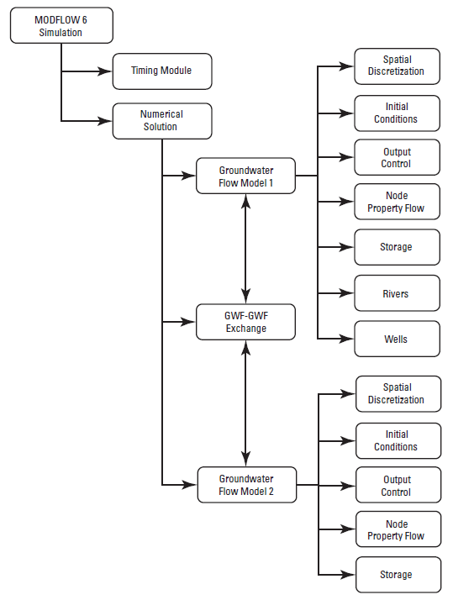
Multiple models, multiple cores…
Earlier today: MODFLOW 6 has conceptualized a process model into a “Numerical Model”
and allows simultaneous solution of multiple, connected Numerical Models
Our approach: distribute models over processor cores and solve the Numerical Solution in parallel

Slide 3

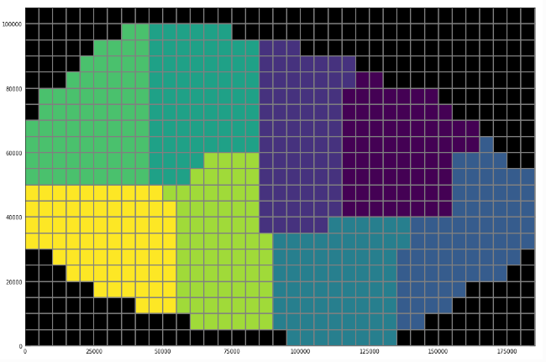
Functional Requirements
(A)
Case A:
End-user can run a large integrated, multi-domain, multi-process simulation in parallel
Case B:
End-user can split up large model, run in parallel, merge results, and analyze as if it were a single model
(B)
Notes:
A: every color represents a model
B: a single model, partitioned into subdomains

Slide 4
Non-functional Requirements
Serial and parallel executable from the same source files without duplications
MODFLOW remains distributable in its core set of functionality, without MPI and other 3rd party dependencies
Parallel capabilities as loosely coupled extension to the serial code base: maintenance and development of packages possible without knowledge on parallel MODFLOW, MPI, etc.
Always possible to run a parallel model in serial mode (when memory allows)
FloPy support for pre- and post-processing
Targeting Windows, Linux, MacOS
Notes:
Somebody at MODFLOW and More (Princeton): “Why don’t you just do it?? Only takes 4 weeks…”
Invasive: “this has MPI all over the place”
Alternatively, many version of the same code but MODFLOW 6 was meant to remedy exactly that
Single effort scalable over current and future process models
MODFLOW should remain easy to distribute, install, run on a variety of platforms, for the different types of users:
“Wait, there is no MPI implementation on our company’s laptops”
“I don’t want to end up compiling lots of stuff I don’t need”

Slide 5
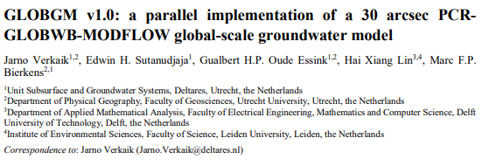
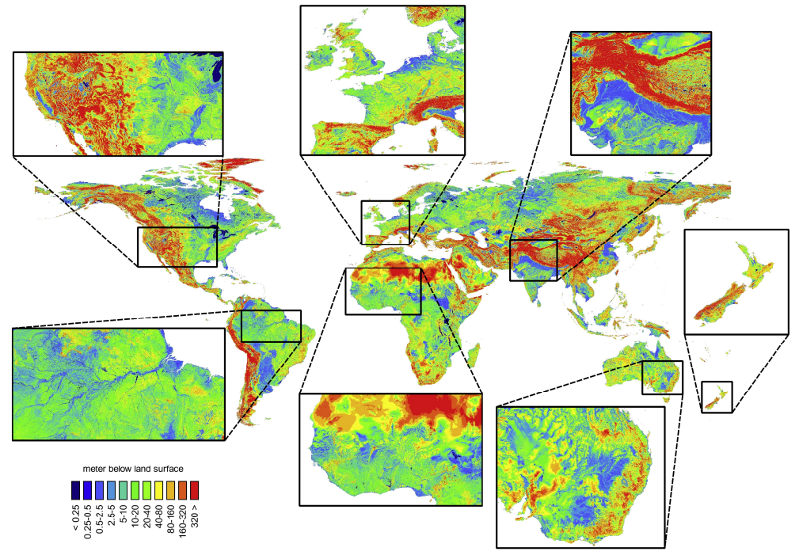
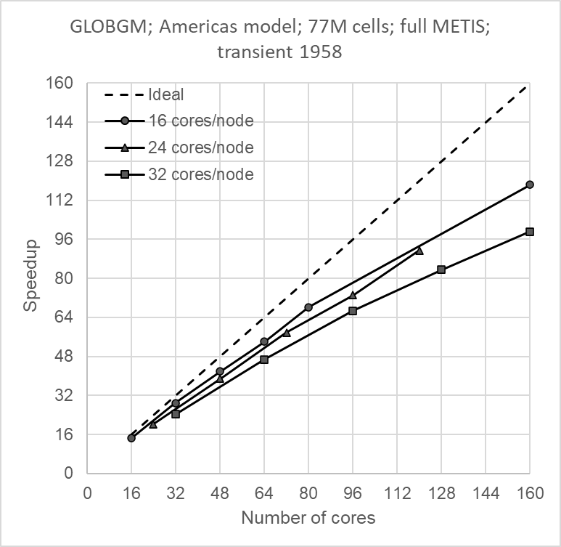
Prototype
Results from parallel prototype for GWF with the standard conductance formulation

Slide 6
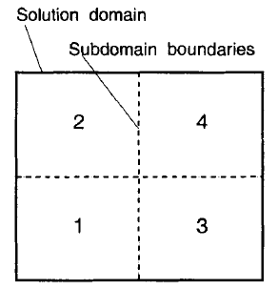
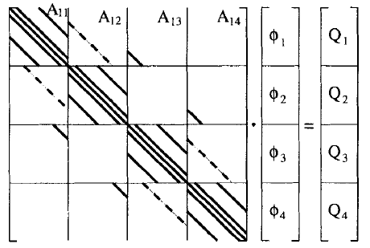

Parallel Solution
Say, we have 4 cores
Our simulation is defined as 4 coupled models (or domains)
Then there is a global system Aφ = Q
Then vectors are distributed over processes: φ_{i} , Q_{i}
Each process owns a contiguous set of matrix rows: A_{1j},A_{2j},A_{3j},A_{4j}

Slide 7
Parallel Solution
How to solve Aφ = Q in parallel?
Split matrix
A = M - N (with M “easily” invertible)
Define iterative method:
Mφ^{k+1} = Nφ^{k} + Q
Choose M such that the off-diagonal blocks M_{ij} = 0 when i ≠ j
Then, for each block ”i” (i.e. each parallel process)
φ_{i}^{k+1} = (M_{ii})⁻¹ (Σ_{j} N_{ij}φ_{j}^{k} + Q_{i})
No longer depends on φ_{j}^{k+1} (i ≠ j): this can be “efficiently” solved in parallel!

Slide 8
Parallel MODFLOW in concepts
Objective is to distribute the workload:
Step 1: Assemble the linear system in parallel (Formulate)
Step 2: Solve the system (A φ = Q) in parallel
Three corner stones of the method:
1. Generalized coupling of models in space
2. Virtualization of distributed data
3. Solving the system of equations in parallel

Slide 9
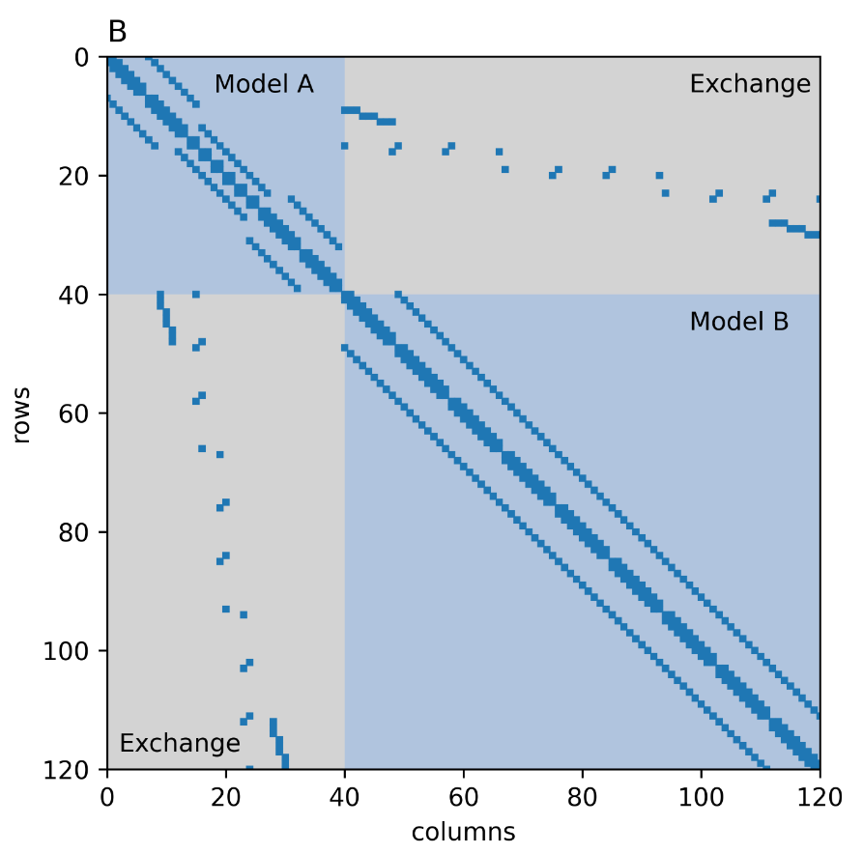
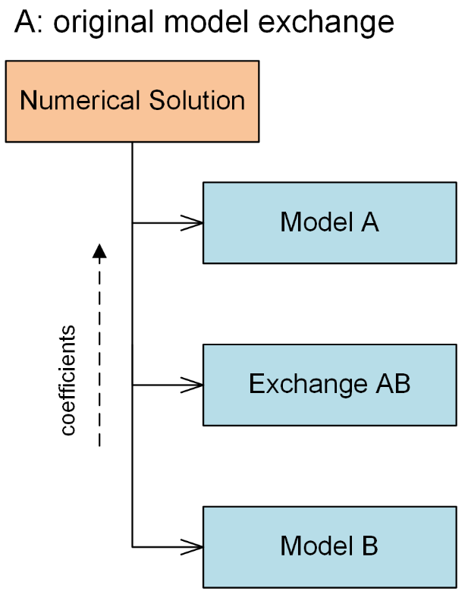
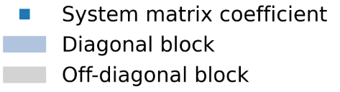
1. Generalized Coupling Serial Assembly
Notes:
Explain how models and exchanges translate into matrix structure here.

Slide 10
1. Generalized Coupling Serial Assembly
Notes:
Explain how models and exchanges translate into matrix structure here.

Slide 11
1. Generalized Coupling Serial Assembly
Notes:
Explain how models and exchanges translate into matrix structure here.

Slide 12
1. Generalized Coupling Parallel Assembly
CPU 1
??
CPU 2
Notes:
Explain how models and exchanges translate into matrix structure here.

Slide 13
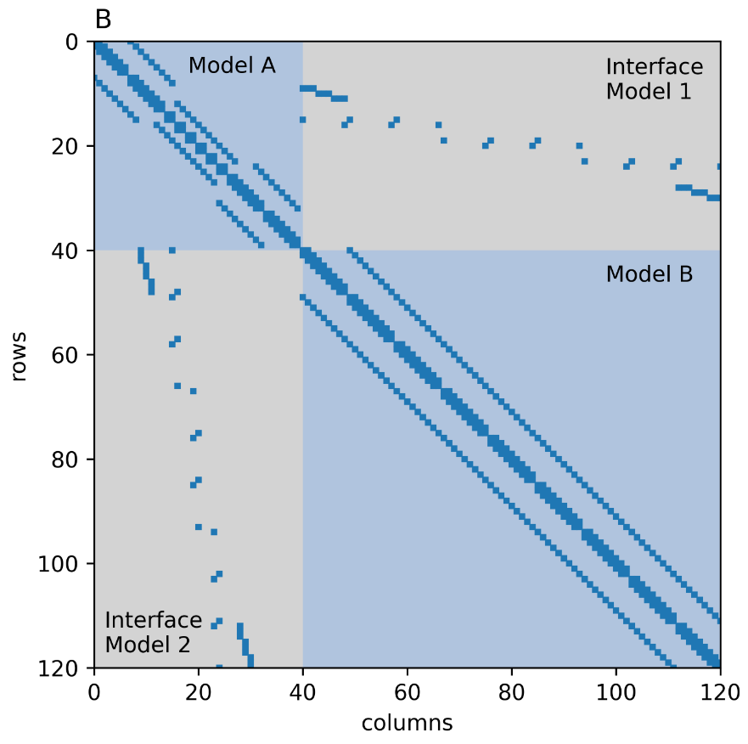
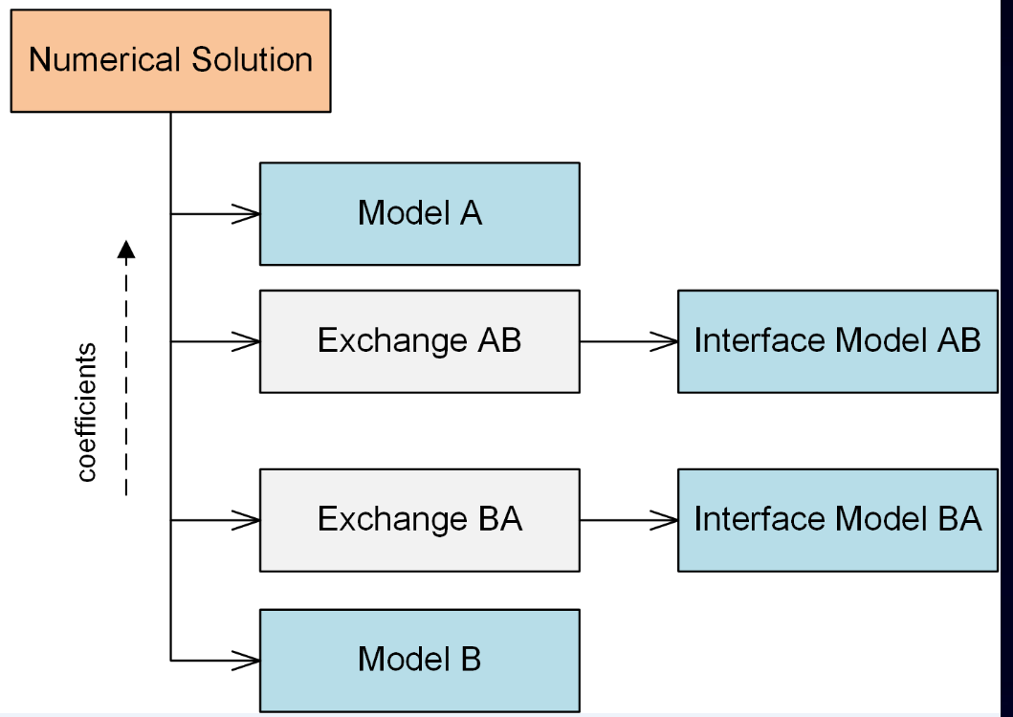
1. Generalized Coupling Parallel Assembly
CPU 1
CPU 2
Notes:
Mention purpose of the Interface Model here

Slide 14
1. Generalized Coupling Parallel Assembly
Brief note on the Interface Model:
A purely technical construct for coupling numerical models.
It works behind the scenes and is not a real model. No need to configure it, nor does it produce any output.
Notes:
Mention purpose of the Interface Model here

Slide 15
1. Generalized Coupling Interface Model
Constructing the equations at the interface (Exchange) posed a software engineering challenge:
Duplication of code
Advanced concepts (XT3D) can not be efficiently implemented
Repetition when adding new process models
The “Interface Model” is designed to formulate the balance equation at the model boundary
It mimics (type extension) a real flow or transport model so that it can use all existing data structures and procedures
It is purely technical construct, no user input required
The discretization is determined automatically from the existing Exchange
It is generalized: applies to (future) numerical process models in general

Slide 16
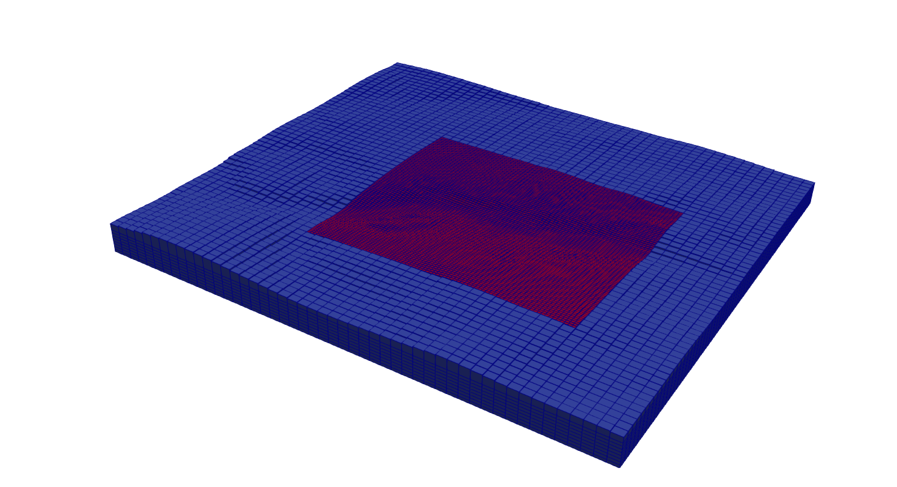
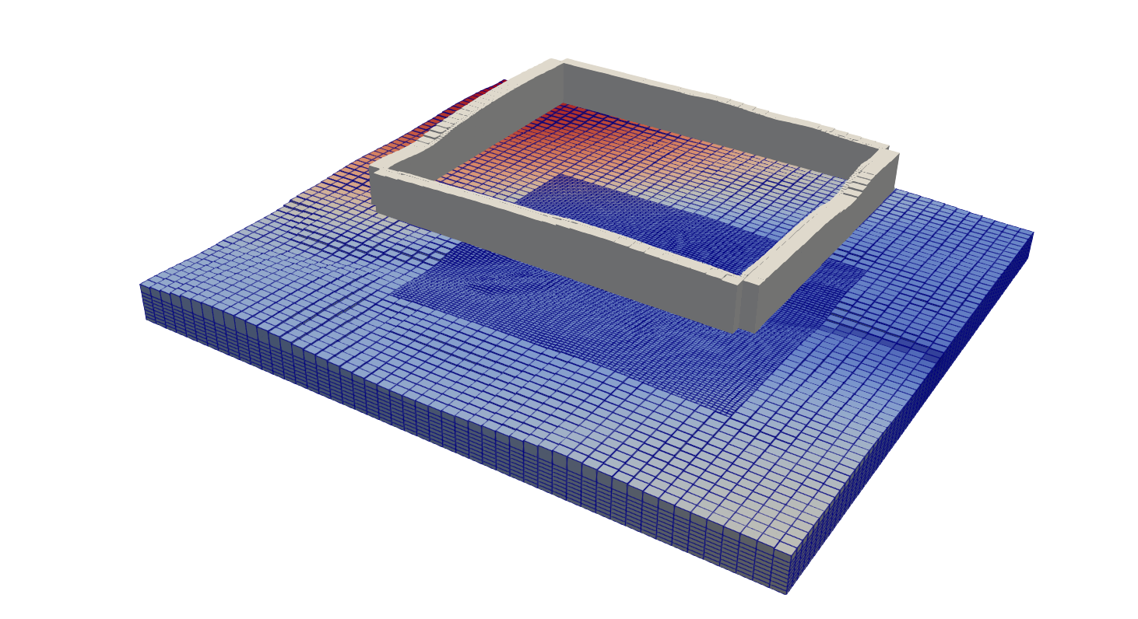
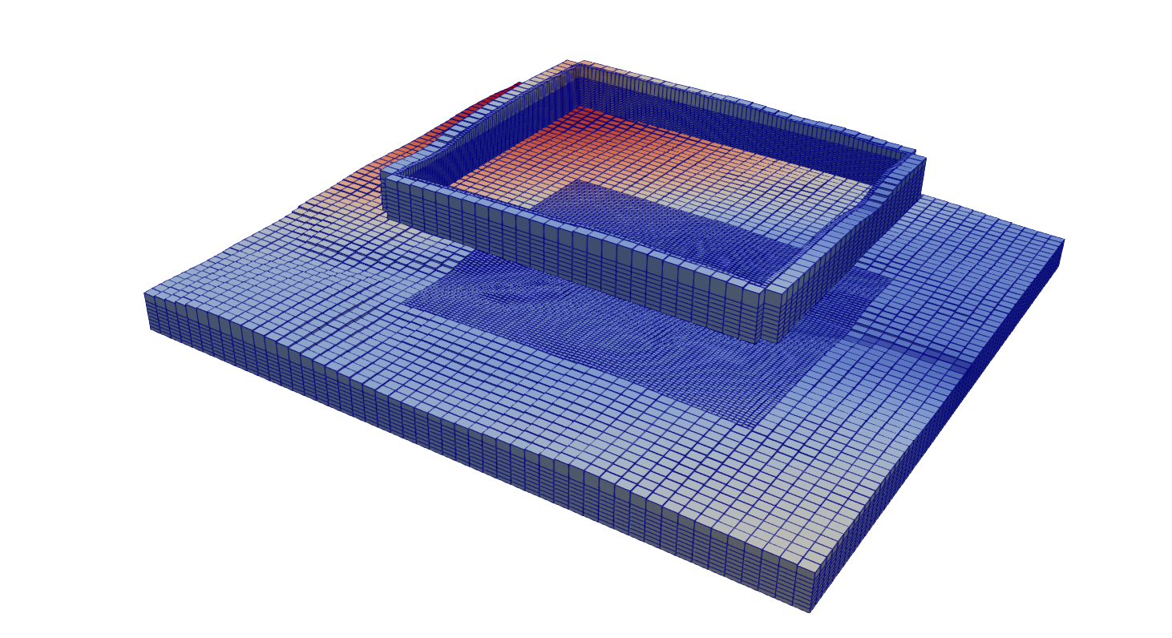
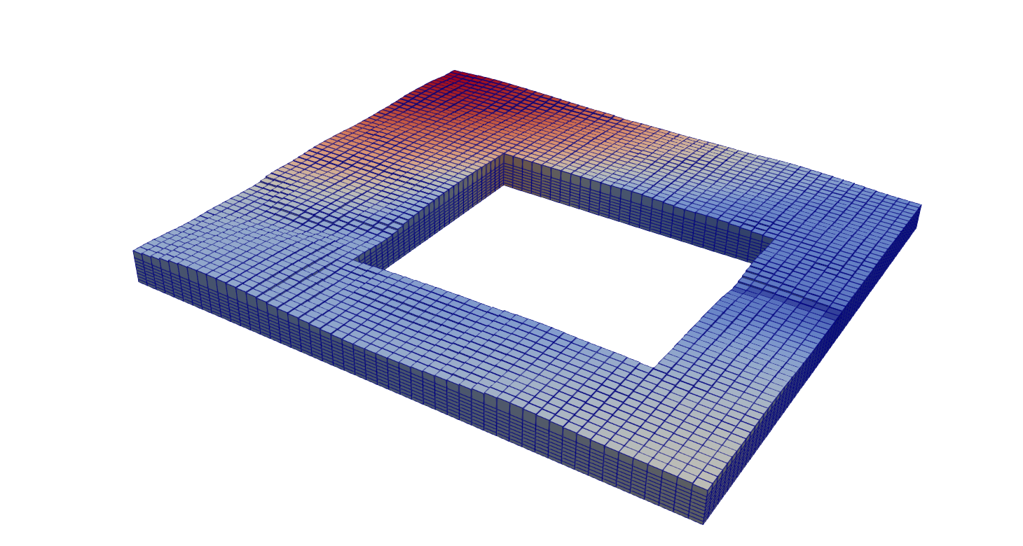
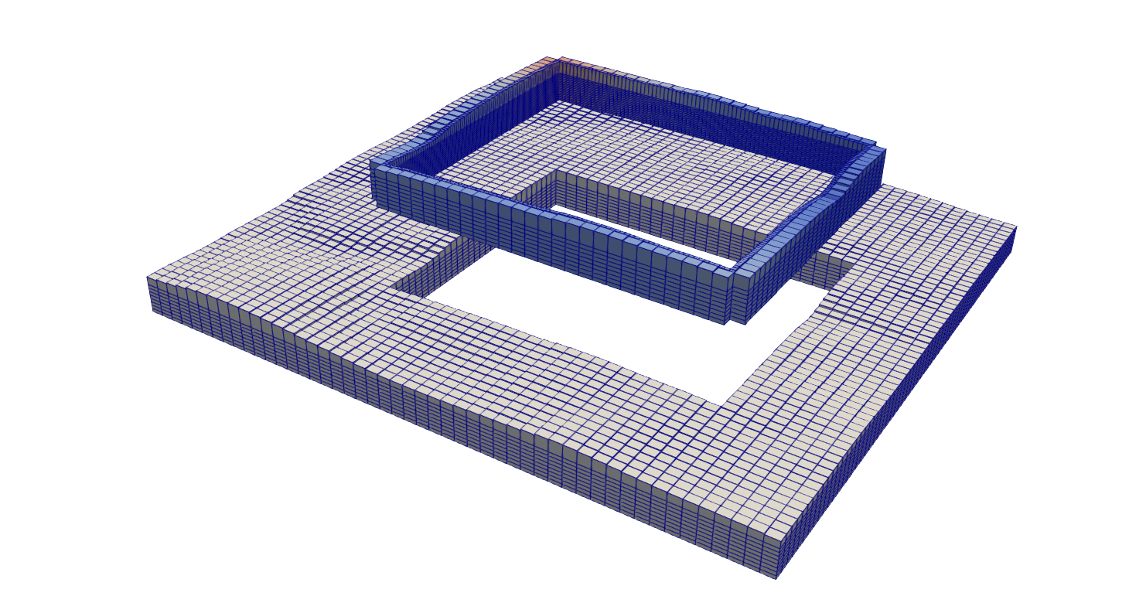
1. Generalized Coupling Interface Model
This step requires synchronization over processes: Virtual Data
Case: 2 Models, 1 Exchange
Construct grid around interface
Create Model with interface grid
Copy configuration data from models
Update state variables
Calculate Model coefficients
Put Model coefficients into linear system
Calculate Interface coefficients
Put Interface coefficients into linear system

Slide 17
2. Virtualization of Data
CPU 1
Fill with data from Model A
But, data from Model B is inaccessible…
CPU 2

Slide 18
2. Virtualization of Data
CPU 1
in-memory link*
Virtual Data Store
Copier
Virtual Model A
Virtual Model B
MPI link
CPU 2

Slide 19
2. Virtualization of Data
CPU 1
in-memory link*
Virtual Data Store
Copier
Virtual Model A
Virtual Model B
MPI link
Virtual Data Store
Virtual Model A
Copier
Virtual Model B
in-memory link
CPU 2

Slide 20
3. Parallel Solver
Remember, three corner stones of our design:
1. Generalized Coupling of models in space ✓
2. Virtualization of distributed data ✓
3. Solving the system of equations in parallel
Different options:
Extend IMS Linear Solver to work in parallel
Use of a 3rd party library
both

Slide 21

3. Parallel Solver
The Portable, Extensible Toolkit for Scientific Computation
Suite of data structures and routines developed and maintained by ANL
Scalable (parallel) solution of scientific applications modeled by partial differential equations
Robust, Efficient, Portable, …
Configurable
Comes with great diagnostic tools
Fortran bindings

Slide 22
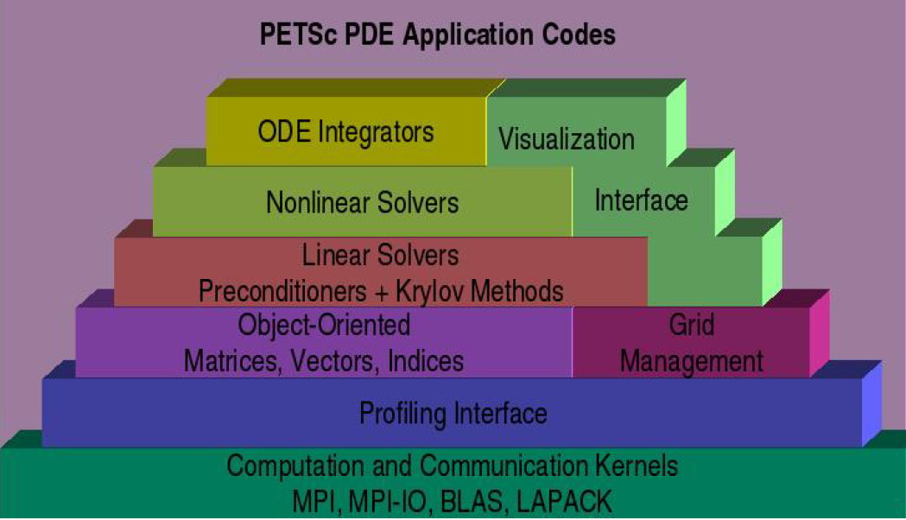
3. Parallel Solver

Slide 23

Questions?

Slide 24
Disclaimer
About current status, put this somewhere

Slide 25
Parallel Iterative Solver
Goal is to solve
A φ = Q
Suppose an iterative scheme
M φ^{(n+1)} = N φ^{(n)} + B
Then
A = M – N
B = Q
Then our iteration goes
M_{ii} φ_{i}^{(n)} = Q_{i}^{(n-1)} – (A_{ii} - M_{ii}) φ_{i}^{(n-1)} - Σ_{j} A_{ij} φ_{j}^{(n-1)} (j ≠ i)

